Slide 1

Statistical Analysis Of Renewable Energy’s Impacts on Economics Growth
A Multivariable Panel Data Analysis of Developed and Developing Countries
Soheil Saadatfar

Slide 2
Approach
Collection of Data
Data Cleaning
Exploratory Data Analysis
Correlation Analysis
Hypothesis Testing
Regression Analysis

Slide 3
Dataset
Development Indicators
Source: World Bank Group
Formal: CSV Panel Data
Panel of Developed & Developing Countries

Slide 4
definitions
GDP_curr_ppp: Current Gross Domestic Product, A monetary Measure of market value of all final goods and services produced.
GFCF (Gross Fixed Capital Formation): Measures value of acquisitions of new or existing fixed assets.
REC_Percentage: Percentage of Renewable energy used
Unemeployment: Total percentage of Unemployment
CO2_emission: kilotons total CO2 produced.

Slide 5
Questions
Are short term & long term effects equally beneficial for all types of economy?
Could Increasing costs of such transformations negatively affect growth of an economy?
Is there relationship between advancement in renewable energy and GDP?
Is there a significant relationship between employment and renewable energy?
Where does Canada stand in the new world of clean energy?

Slide 6
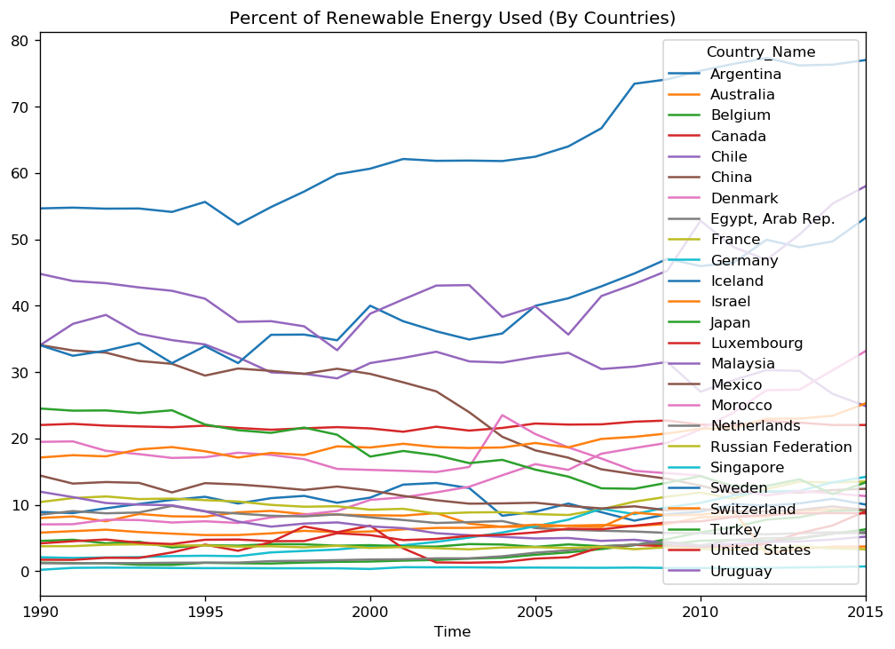
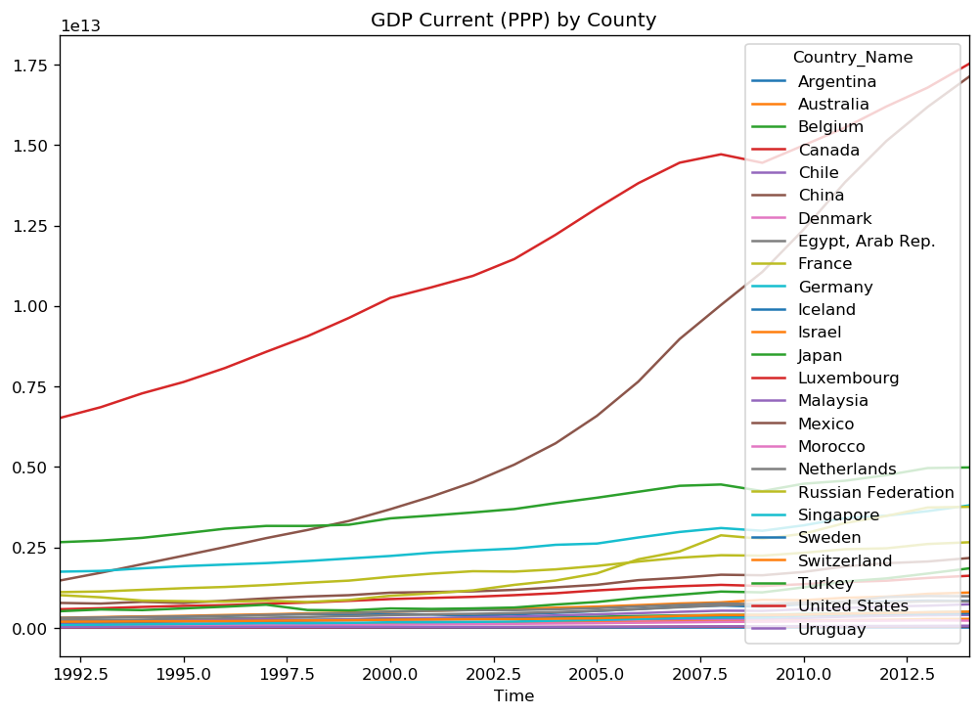
Staionarity

Slide 7
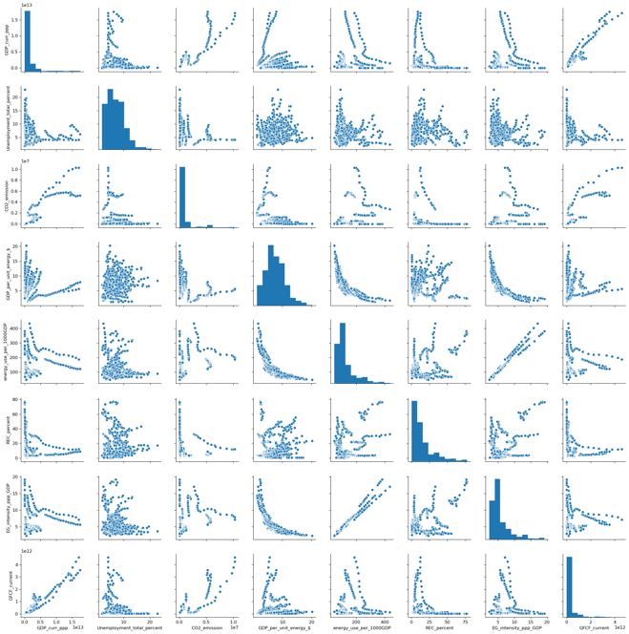
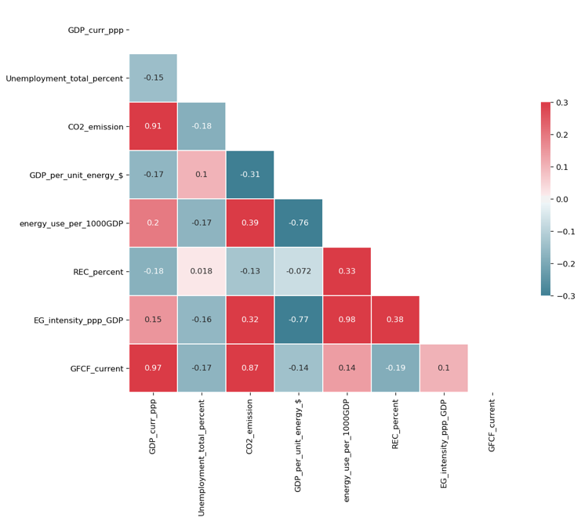
Correlation

Slide 8
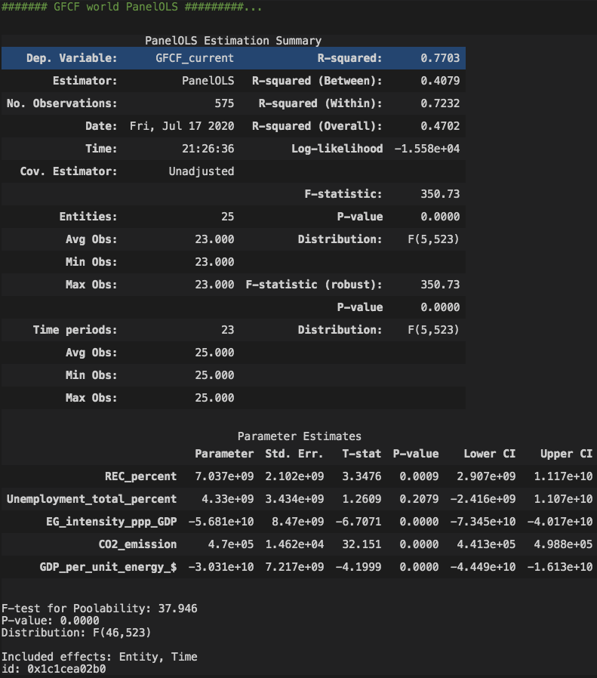
Is the world’s economy driven by energy ?
World GFCF
All variables but Unemployment show signs of significance
77.03% of variation in GFCF is explained by energy related independent variables.
Enough evidence to suggest relation between Gross Fixed Capital formation and energy .

Slide 9
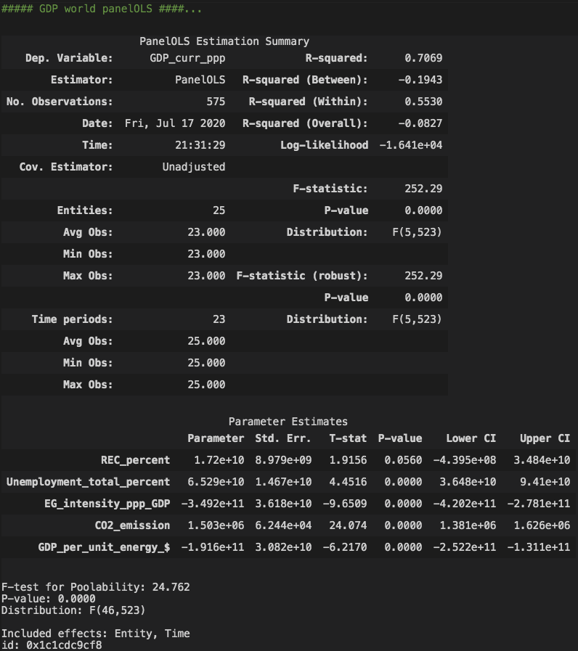
Is the world’s economy driven by energy ?
World GDP
GDP Model: REC% less significant.
All other variables are significant
70.69% of variation in GDP is explained by independent variables
The amount of energy used is relevant, but type of energy has no significant short term effect on GDP.

Slide 10
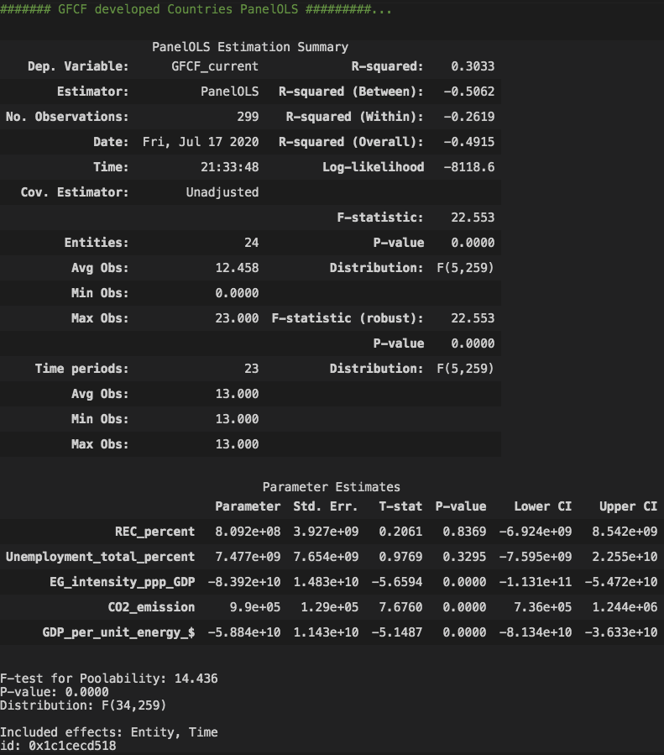
Does renewable energy have similar effect on all types of economy?
Developed countries GFCF
GFCF: REC% & unemployment are insignificant
Only 30.33 of variation in GFCF of developed countries is explained by independent variables
Relevance of energy has decreased.

Slide 11
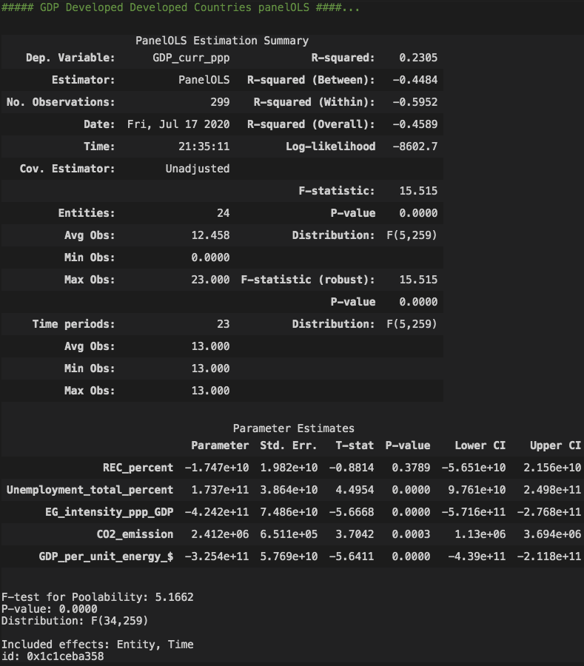
Does renewable energy have similar effect on all types of economy?
Developed Countries GDP
GDP: REC% still insignificant.
All other variables are significant
Only 23.05 of variation in GDP of developed countries is explained by independent variables
Relevance of Energy has declined

Slide 12
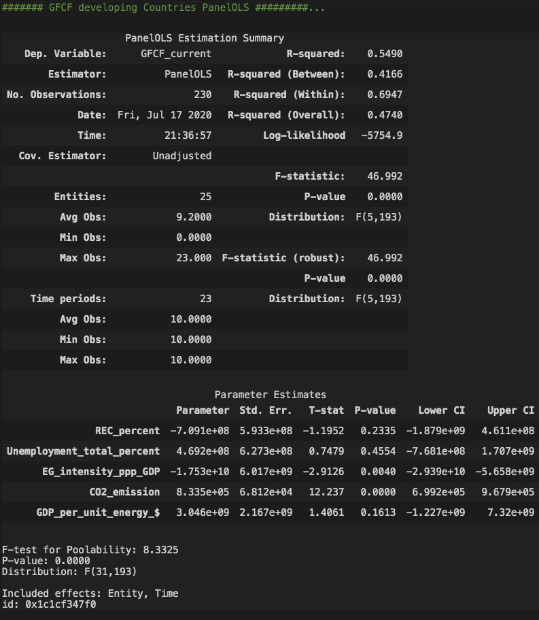
Does renewable energy have similar effect on all types of economy?
Developing Countries GFCF
GFCF: REC% and Unemployment are insignificant.
54.90% of variation in GFCF of developing countries is explained by independent variables
Relevance of Energy has increased compare to developed countries.
Developing countries show more signs of economical expansions possibly related to better energy allocations.

Slide 13
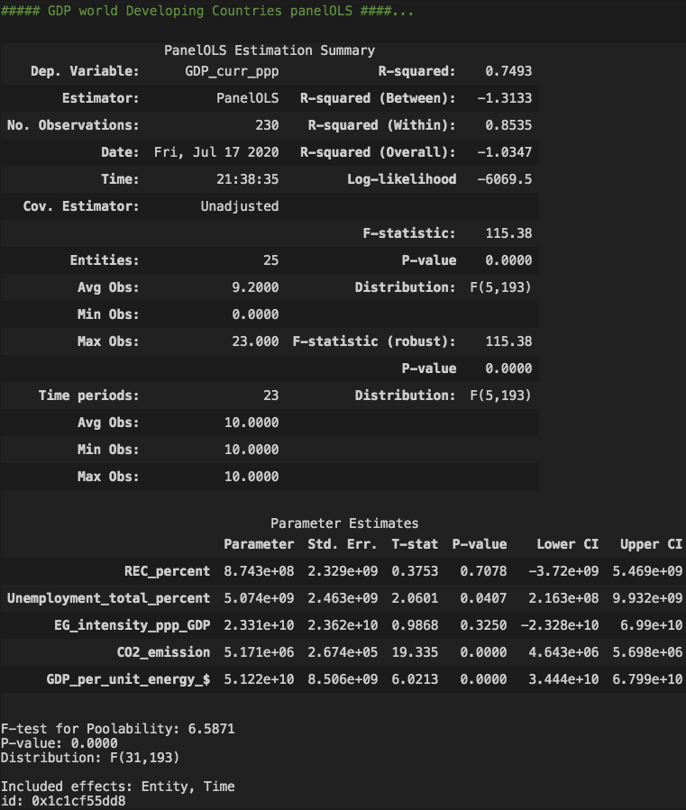
Does renewable energy have similar effect on all types of economy?
Developing Countries GDP
GDP: REC% and Energy intensity are insignificant.
74.93% of variation in GDP of developing countries is explained by independent variables
Relevance of Energy has increased compare to developed countries.
Developing countries show more signs of short and long term influence of energy on their GDP compare to developed countries

Slide 14
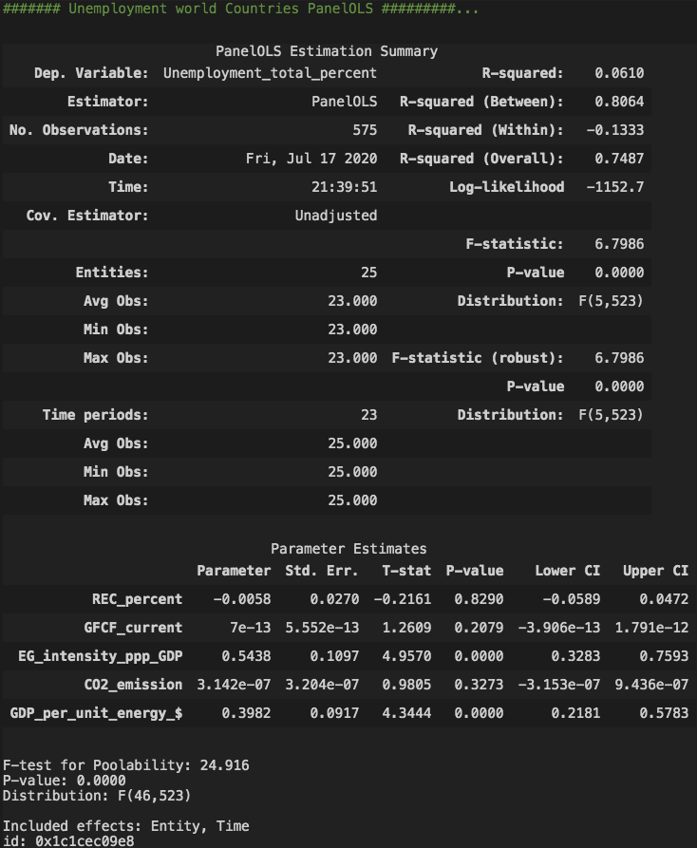
Is there a significant relationship between employment and renewable energy?
World Unemployment
Unemployment: REC%, GFCF and CO2 are insignificant.
Only 6.10% of variation in Unemployment of The world is explained by independent variables
Uneployment has a very insignificant relation with renewal energy and energy.
Suggest that switching to renewal energy has minimal effects on unemployment in economies.

Slide 15
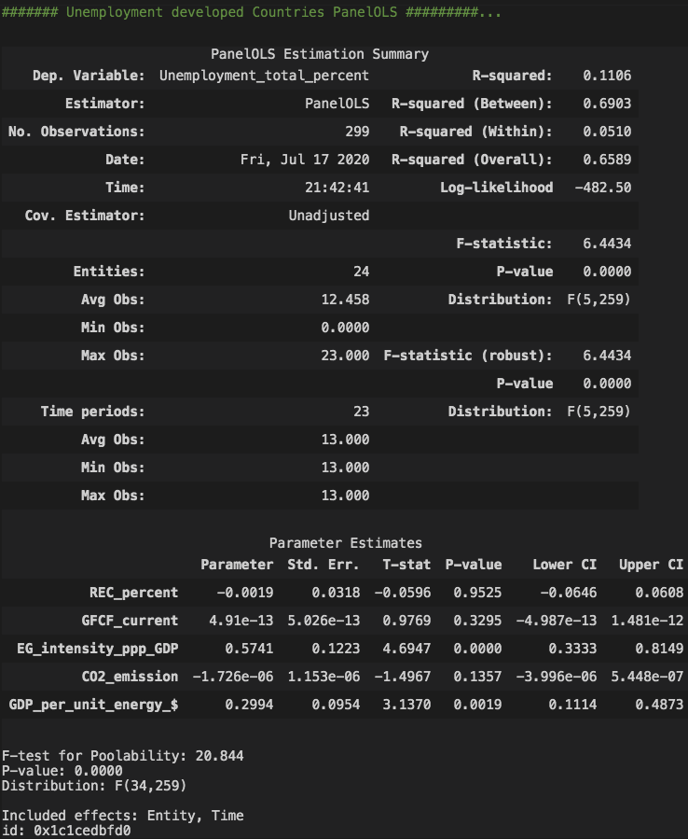
Is there a significant relationship between employment and renewable energy?
Developed Countries Unemployment
Unemployment: REC%, GFCF and CO2 are insignificant.
Only 11.06% of variation in Unemployment of Developed countries is explained by independent variables
Unemployment has a very insignificant relation with renewal energy and energy.
Suggest that switching to renewal energy has minimal effects on unemployment in economies.

Slide 16
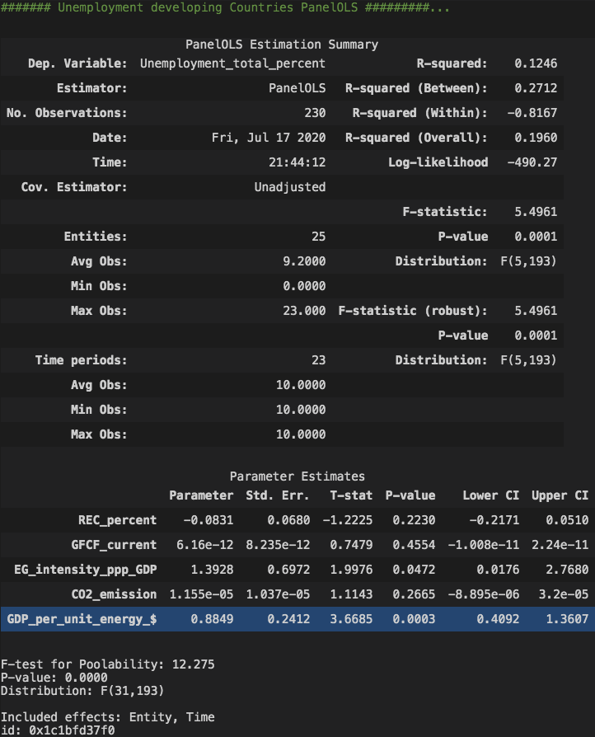
Is there a significant relationship between employment and renewable energy?
Developing Countries Unemployment
Unemployment: REC%, GFCF and CO2 are insignificant.
Only 12.06% of variation in Unemployment of Developed countries is explained by independent variables
Unemployment has a very insignificant relation with renewal energy and energy.
Suggest that switching to renewal energy has minimal effects on unemployment in economies.

Slide 17
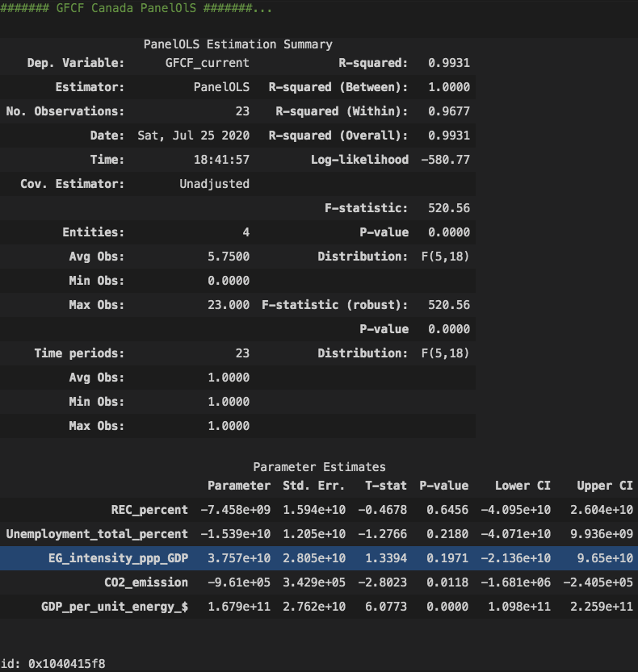
Where does Canada stand in the new world of clean energy?
Canada GFCF
GFCF: all but CO2 and GDP per unit are insignificant
99.31% of variation in GFCF of Canada is explained by independent variables. Indicating overfitting of the model and need of more historical data to analyze
Min, Max and visual graph indicated lack of noticeable growth in renewable energy percentage (~21-23%)
Even correlation focus model (firstdifferenceols) only indicated variable significance in uneployment and GDP_per_Unit.

Slide 18
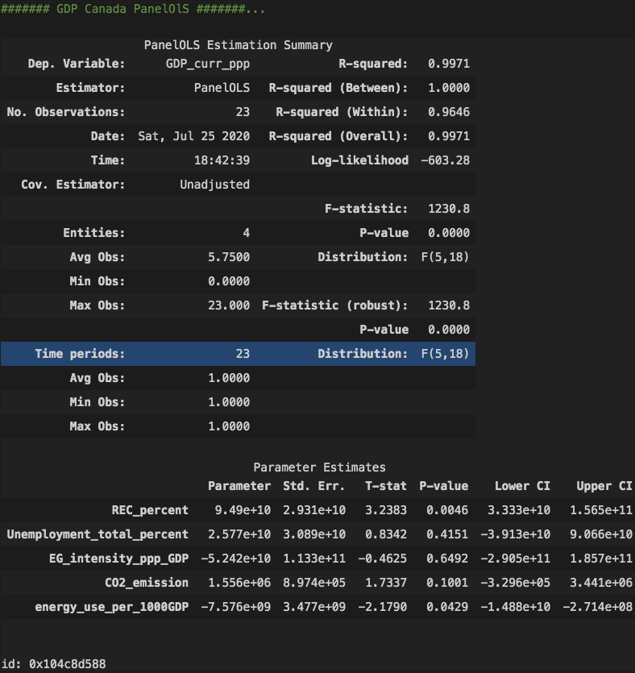
Where does Canada stand in the new world of clean energy?
Canada GDP
GDP: Similar results to GFCF
99.71% of variation in GDP of Canada is explained by independent variables. Indicating overfitting of the model and need of more historical data to analyze
Min, Max and visual graph indicated lack of noticeable growth in renewable energy percentage (~21-23%)

Slide 19
Conclusion
World economy is influence by energy as a whole.
Developing counties are more susceptible to advancement and uses of renewable energy than developed countries.
There is insignificant relation between GDP and renewable energy but significant relation with total energy use. Perhaps the investment in REC can have more benefit for humans well being than harm
Trading of traditional energy resources for renewable has little to no effect on unemployment rate. Doing so in moderate could only have long term benefits for the world.
Although Canada had one of the best start in 1990, Its growth in utilizing renewable energy has been insignificant. More data and studies are required if there is any significant changes to these numbers.

Slide 20
Questions?

